Slide 1
Riding the Waves of Crypto and Stocks: NLP-Powered Voyage through Reddit's Investment Chatter

Slide 2
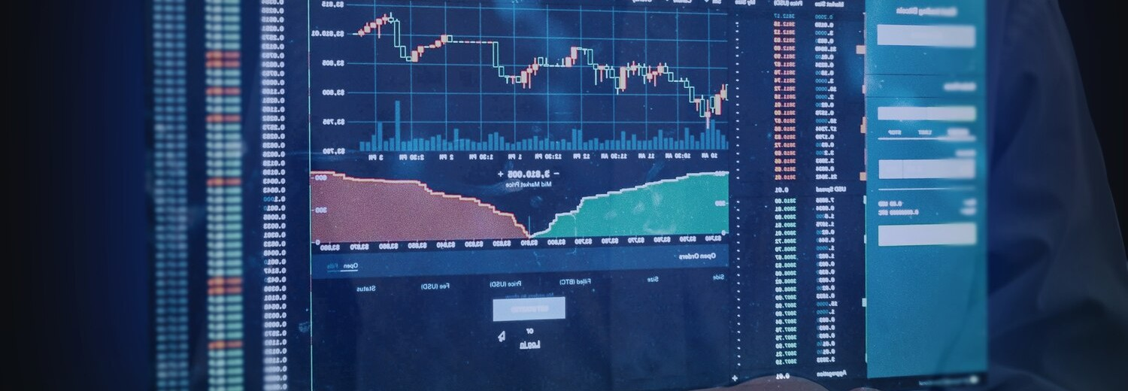
Develop a binary NLP classifier to distinguish between crypto and stock posts found on the r/wallstreetbets and r/CryptoMoonShots subreddits. This will help users identify investment opportunities in both markets and potentially inform trading decisions based on which assets are popular/rising. #ShortSqueeze #TotheMoon

Slide 3
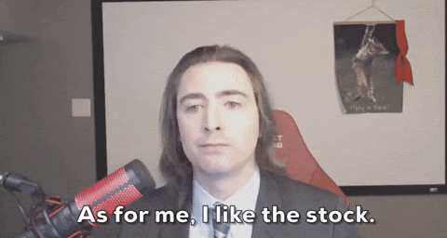

r/wallstreetbets
Meme Stonks & Retail Rebellion: WallStreetBets rose to fame during the pandemic with the GameStop saga. Users coordinated massive stock purchases, popularizing the term "meme stocks" and challenging Wall Street institutions. This "casino-style" approach to the market has become a point of legal concern.
RoaringKitty (Keith Gill): popularized the GameStop short squeeze in 2021, raising questions about retail investor influence and sparking a trial that could define legal boundaries for online financial communication.
Financial Lingo Goes Viral: WSB's crass humor and unique financial slang ("diamond hands," "to the moon") became mainstream conversation in financial news.

Slide 4

r/CryptoMoonShots
Community Shilling & High Risk: The subreddit thrives on user recommendations and promotions (shilling) of unproven cryptocurrencies. This can lead to high-risk investments and frequent scams.
"To the Moon" & Memes: Similar to WallStreetBets, CryptoMoonShots uses memes and internet slang ("to the moon," rocket emojis) to express excitement about crypto gains.
Focus on Price & Short-Term Gains: Discussions often center around short-term price movements and potential profits, rather than the underlying technology or long-term viability of crypto projects.

Slide 5
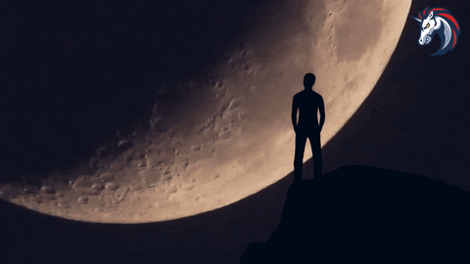
Objectives
Gather and prepare data from the wallstreetbets and CryptoMoonShots subreddits using PRAW (Python Reddit API Wrapper). Extract from top, new and controversial sections of each subreddit.
Preprocess the text data by cleaning, tokenizing, and vectorizing the posts for NLP analysis.
Train and compare classification models –multinomial naïve bayes, random forest trees and logistic regression - to predict whether a post is related to cryptocurrency or stocks.
Evaluate the performance of the models using appropriate metrics such as accuracy, precision, recall, and F1 score.

Slide 6
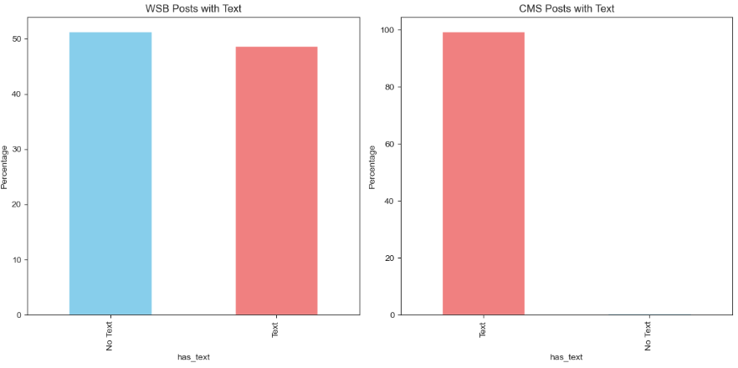
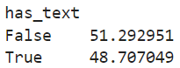
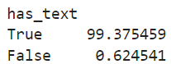

Slide 7
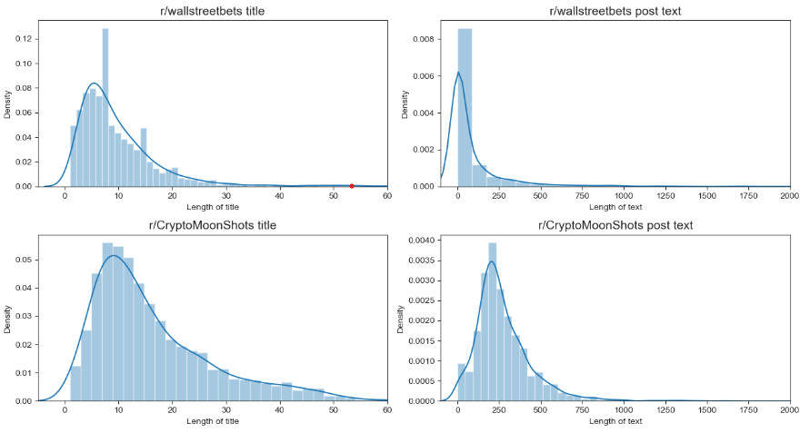

Slide 8
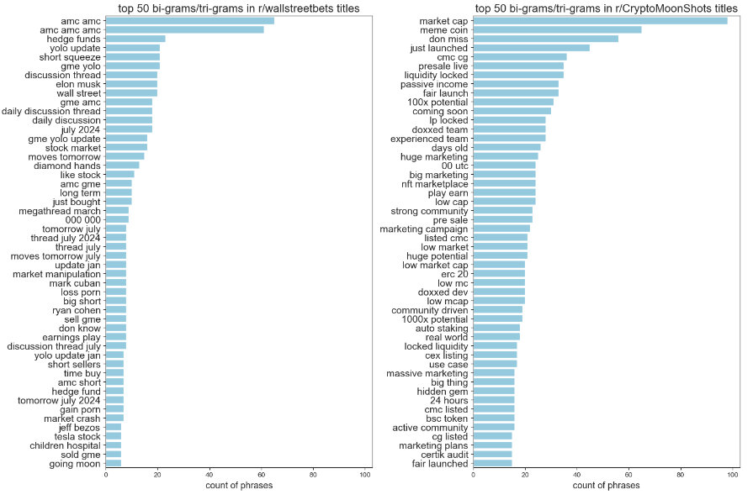

Slide 9
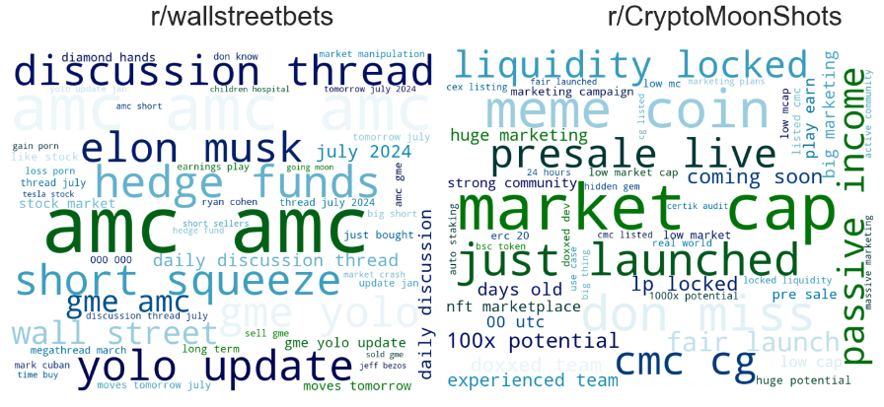

Slide 10
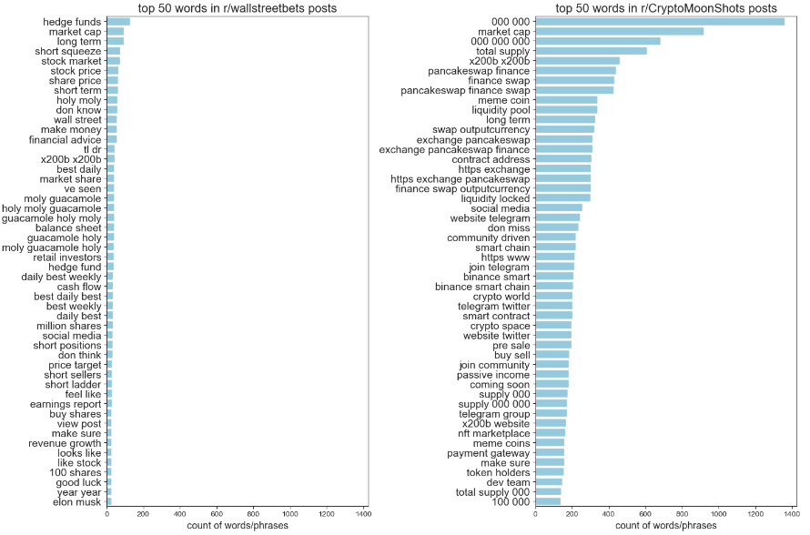

Slide 11
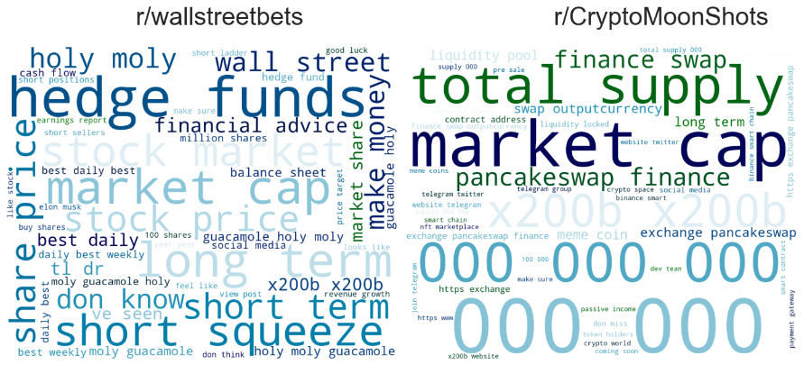

Slide 12
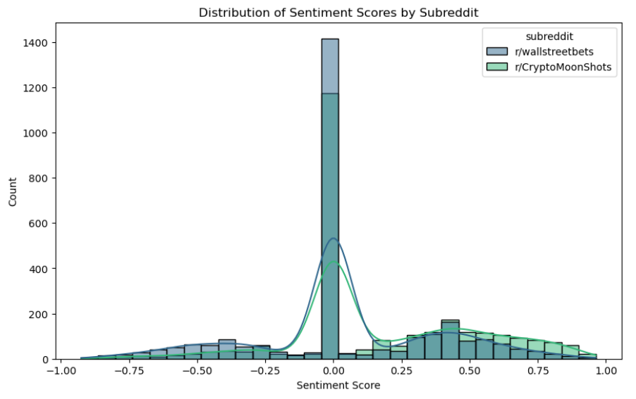

Slide 13
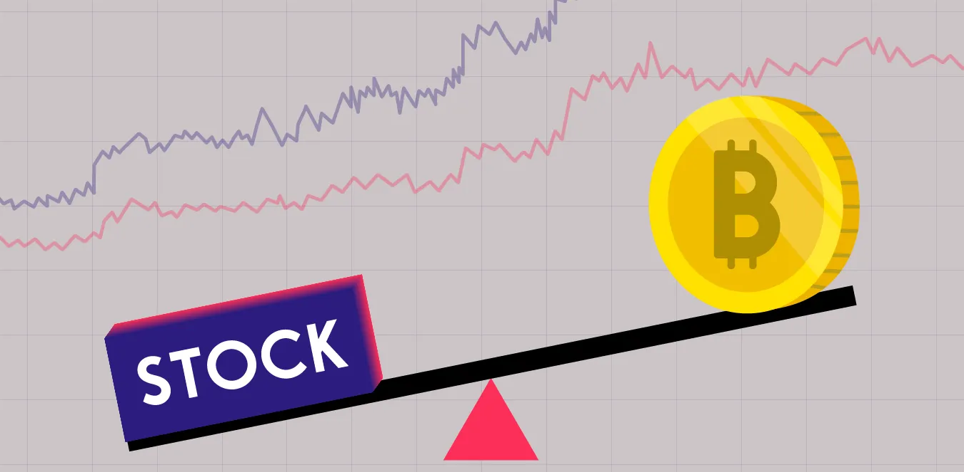

After merging all dataframes into one combined csv file, mapping 0 to r/CryptoMoonShots and 1 to r/wallstreetbets, as well as tokenizing the title text into a processed feature for sentiment analysis, we can establish our baseline accuracy!
Baseline Accuracy – 0.519 or 51.9%

Slide 14
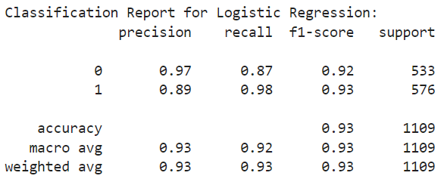
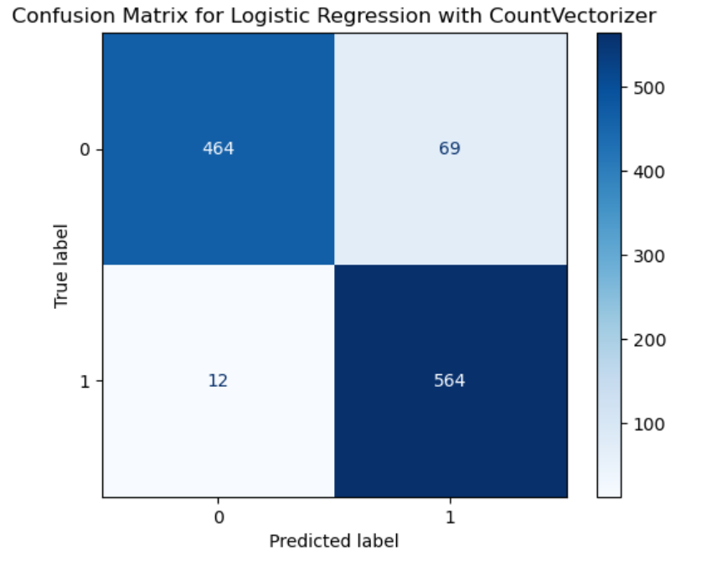
Model 1: Logistic Regression with CountVectorizer
Training Accuracy | Testing Accuracy
0.928 | 0.927

Slide 15
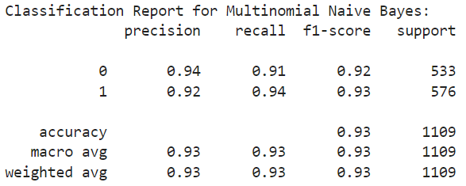
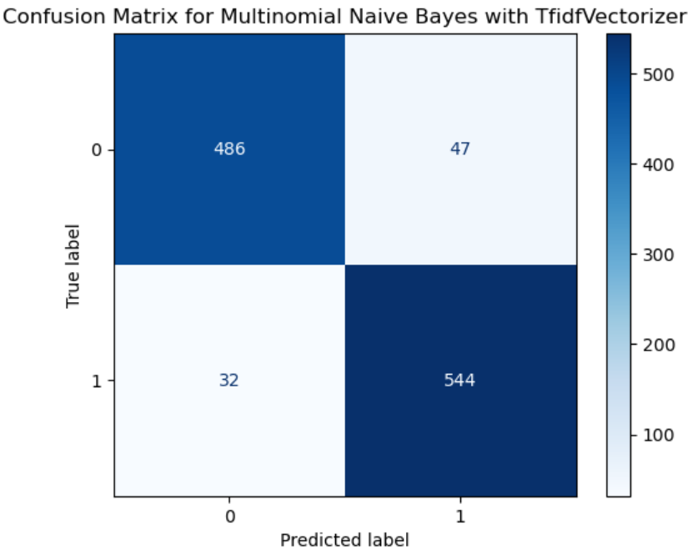
Model 2: Multinomial Naïve Bayes with TfidfVectorizer
Training Accuracy | Testing Accuracy
0.928 | 0.929

Slide 16
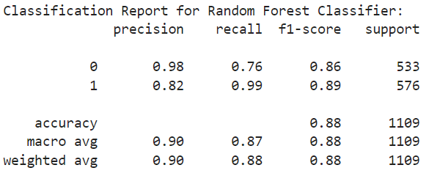
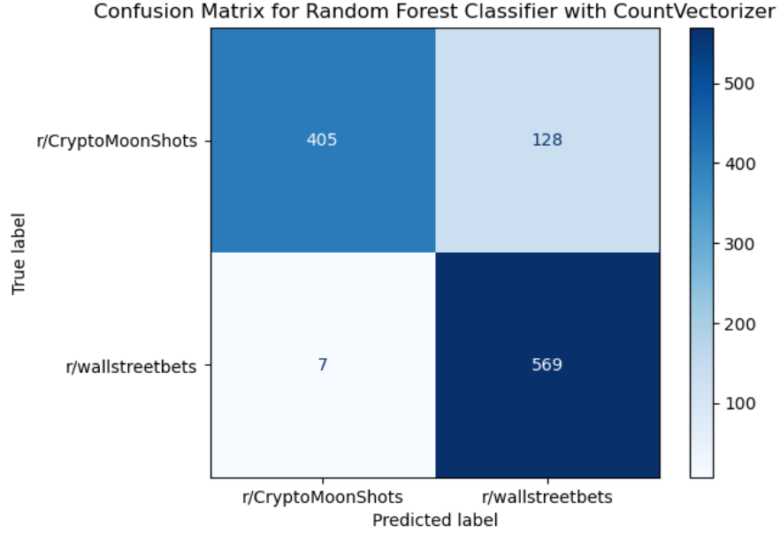
Model 3: Random Forest Tree Classifier with CountVectorizer
Training Accuracy | Testing Accuracy
0.891 | 0.878

Slide 17
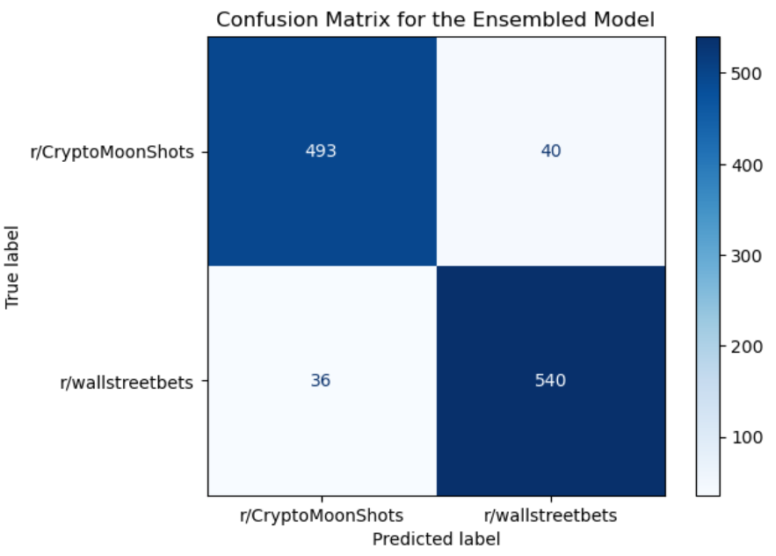
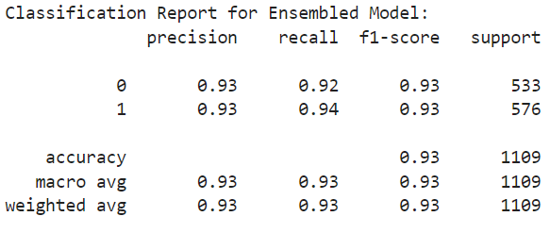
Model 4: Ensemble Model (Logistic Regression & Multinomial Naïve Bayes)
Testing Accuracy
0.931

Slide 18
Conclusions/Insights
Precision, Recall, F1-score, and Accuracy: The ensembled model has similar performance to the first two individual models, with high precision of 0.93, recall of around 0.93, F1-score of 0.93, for both subreddits and an overall accuracy score of 0.93.
This will give more of a balance with the false negatives and positives; with 36 false negatives vs 40 false positives! Let's choose this ensemble model for production!

Slide 19
Thanks!

